Slide 1
CAT Investigation :)
By: Dylan K

Slide 2
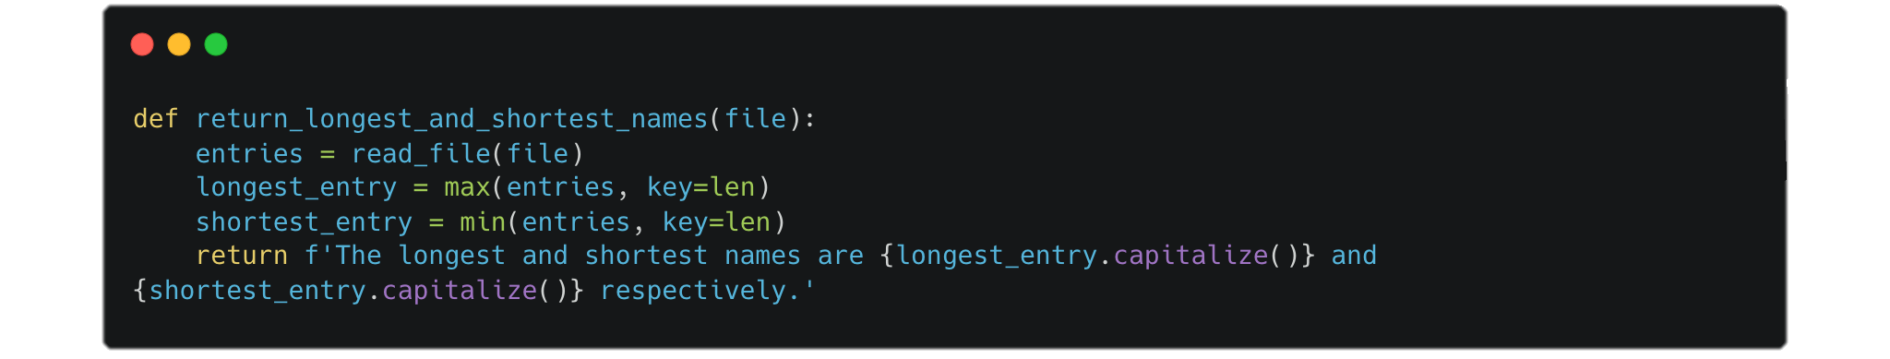
1.1.1 The list of names
The dataset of names has 32033 entries with 29494 being unique names. To find the longest and shortest names, we can use Python’s in-built min and max sorting functions and set the key as len, being the length of any given entry. The returned value is an f-string.
Result: The longest name is Muhammadibrahim, and the shortest name is An.

Slide 3
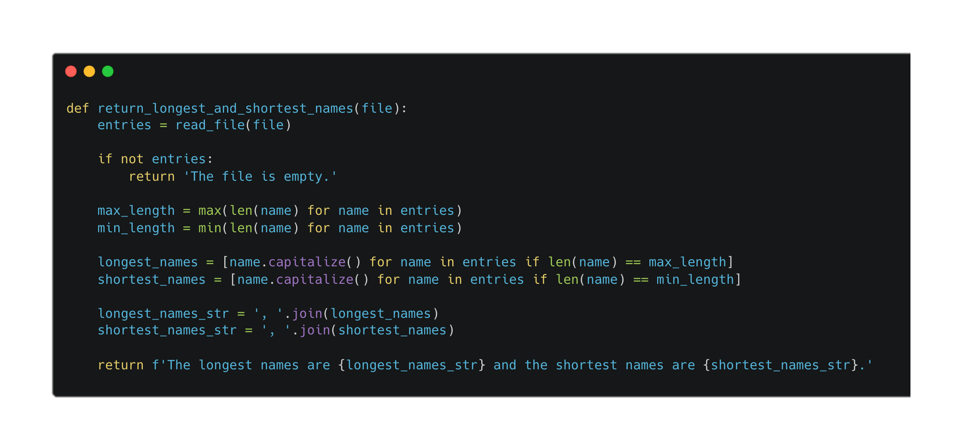
1.1.2 The list of names (cont)
However, this code doesn’t consider if there are multiple shortest, or longest, names of the same length. We can fix this by removing the key and changing the way we find the longest and shortness entries (names).

Slide 4
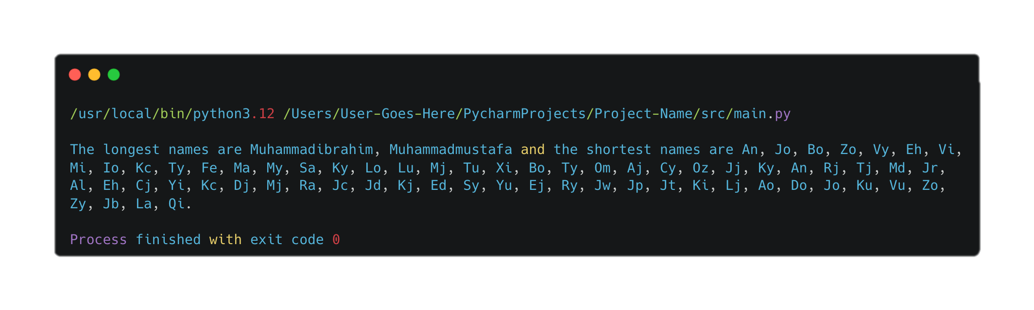
1.1.3 The list of names (cont)
The result of running that code is as follows:
The longest names are Muhammadibrahim, Muhammadmustafa and the shortest names are An, Jo, Bo, Zo, Vy, Eh, Vi, Mi, Io, Kc, Ty, Fe, Ma, My, Sa, Ky, Lo, Lu, Mj, Tu, Xi, Bo, Ty, Om, Aj, Cy, Oz, Jj, Ky, An, Rj, Tj, Md, Jr, Al, Eh, Cj, Yi, Kc, Dj, Mj, Ra, Jc, Jd, Kj, Ed, Sy, Yu, Ej, Ry, Jw, Jp, Jt, Ki, Lj, Ao, Do, Jo, Ku, Vu, Zo, Zy, Jb, La, Qi.

Slide 5
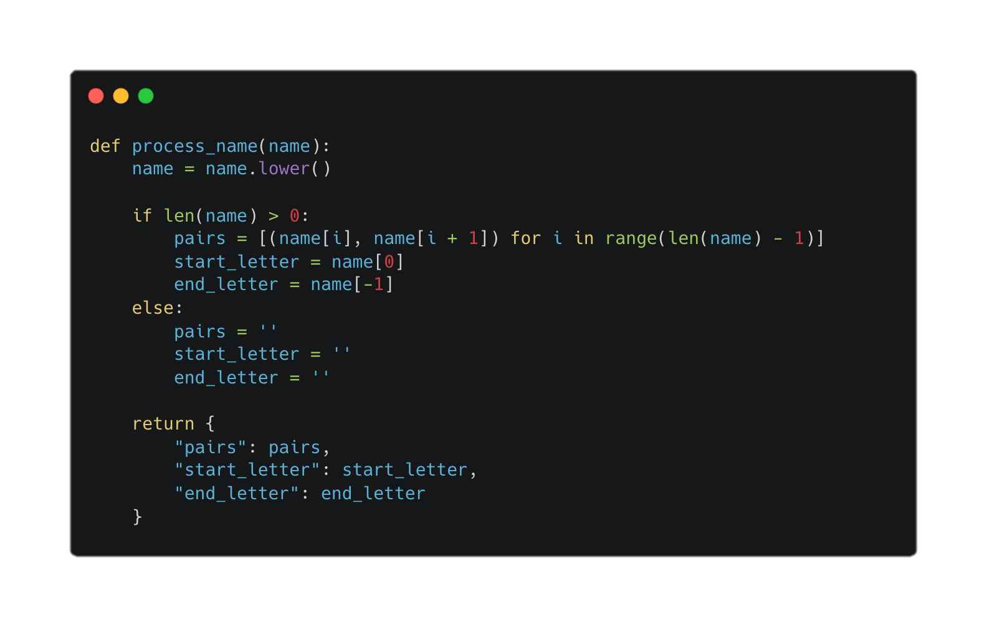
1.2 Preparation for training
To segment the name into pairs of characters containing the current letter and the following letter, we can use the character’s index in the list. First, we convert the name into a list of characters, then we use a for loop to iterate over the indices of the characters.
For each index i, we take the current character name[i] and pair it with the next character name[i+1]. The loop runs until the second-last index, ensuring that there's always a next character to pair with the current one. The pairs are then stored in a list. We can also use the index to get the first and last letter. The returned value is a dictionary.
Error handling has also been added in case an empty string is given

Slide 6
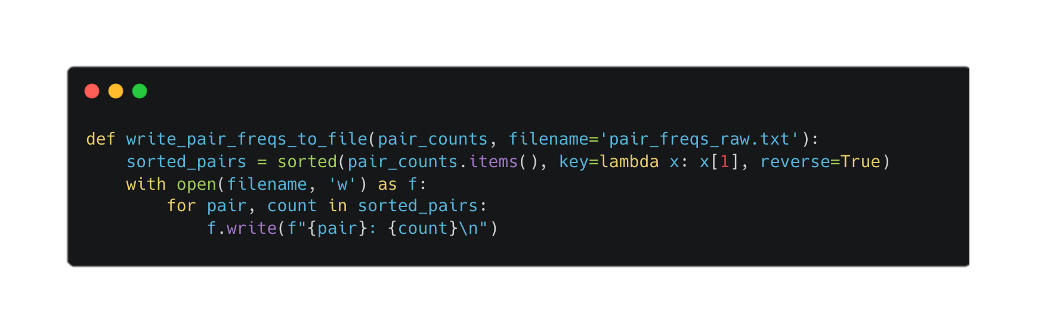
1.3.1 The statistics
To write the frequency of wcletter pairs to a text file, sorted by their occurrence in descending order, we first need to sort the pair_counts dictionary by the frequency values. Using Python’s sorted function, we sort the items of the dictionary, specifying the sorting key as the frequency and setting the reverse parameter to True to ensure a descending order. Once sorted, we open the file in write mode and iterate over the sorted pairs. For each pair and its frequency, we format the output and write it to the file. This method allows us to capture and review the most common letter pairs at the top of the file, clearly reflecting their frequencies.

Slide 7
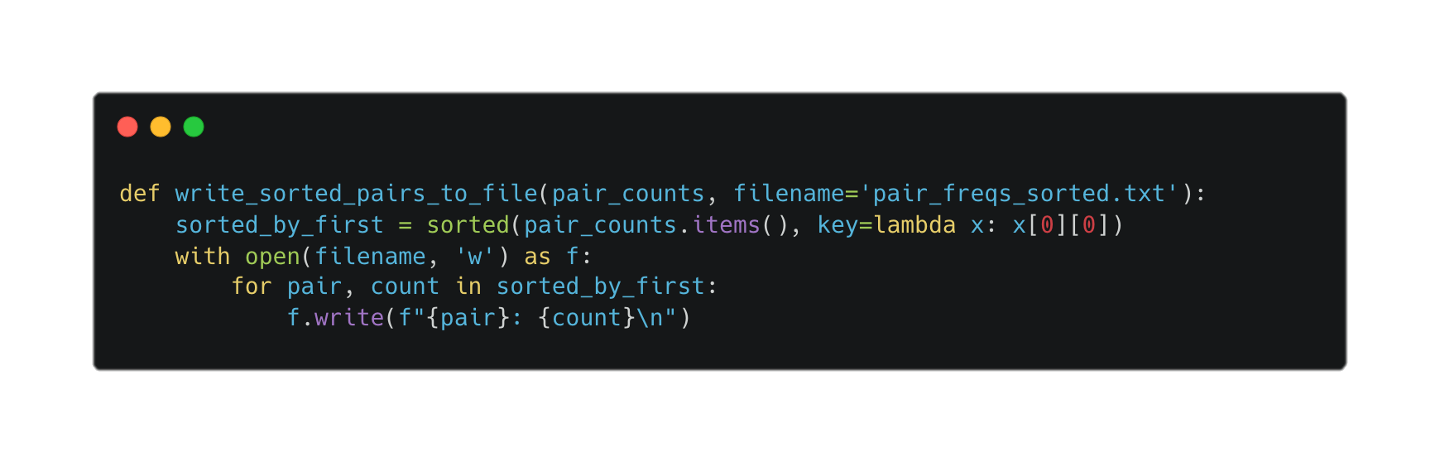
1.3.2 The statistics (cont)
To write the frequency of letter pairs sorted by the first character of each pair, we follow a similar approach but sort the dictionary items differently. By using the sorted function, we specify the sorting key as the first character of each letter pair. This sorts the pairs alphabetically based on their initial character. The file is then opened in write mode, and each sorted pair along with its count is written sequentially. This results in a file where letter pairs are organized in alphabetical order by their first character, which helps in easily locating pairs that start with a specific letter.

Slide 8
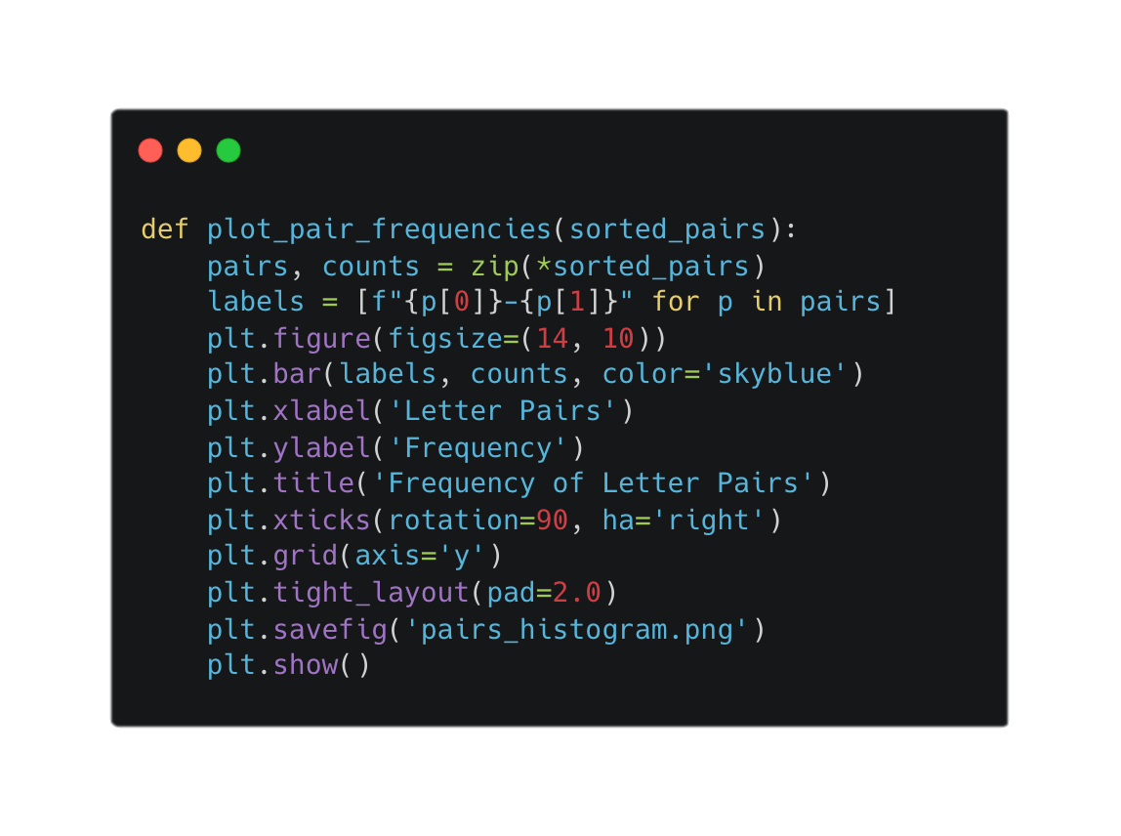
1.3.3 The statistics (cont)
To generate a bar chart visualizing the frequency of letter pairs, we leverage the matplotlib library. We begin by extracting pairs and their counts from the sorted_pairs list. Using matplotlib, we create a bar chart with letter pairs on the x-axis and their frequencies on the y-axis. The chart’s figure size is adjusted to provide ample space for labels, which are rotated to avoid overlap and aligned for readability. Gridlines are added to aid in interpreting the frequency values. The layout is refined with tight_layout to ensure all elements fit neatly within the plot. Finally, the chart is saved as a PNG file and displayed, offering a clear and accessible visual representation of the letter pair frequencies.

Slide 9
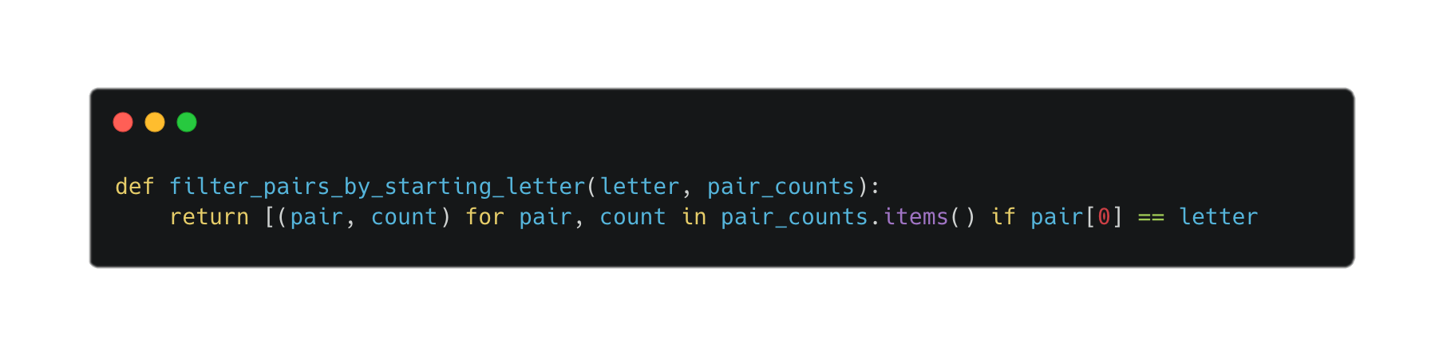
1.3.4 The statistics (cont)
To filter letter pairs that start with a specific letter, we use list comprehension to selectively extract pairs from the pair_counts dictionary. The function takes a letter and the pair_counts dictionary as inputs. By iterating through the dictionary, we collect pairs where the first character matches the given letter. This filtered list, which includes only the relevant pairs and their frequencies, is then returned. This approach enables us to focus on pairs beginning with any specified character, facilitating targeted analysis of the data.

Slide 10
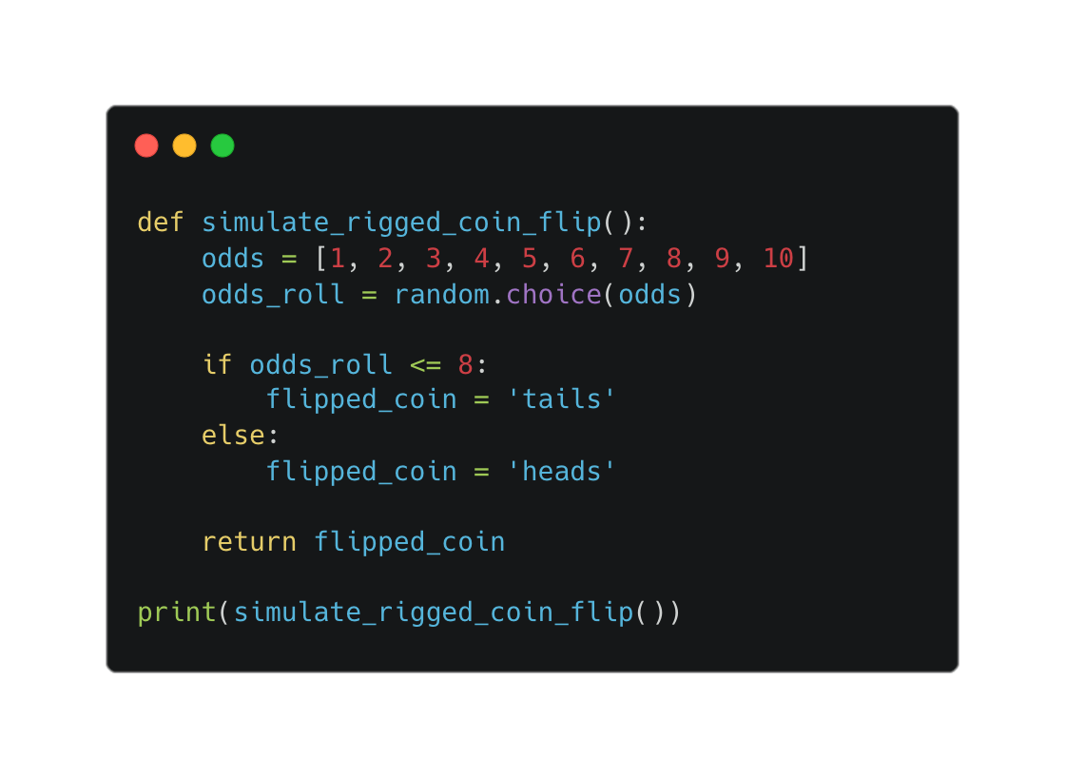
2.1.1 The fundamentals
To simulate a loaded (rigged) coin flip with the odds as follows:
Heads: 20%
Tails: 80%
We can create a list containing the integers from 1 through 10 and use Python’s in-built random module to a number from the list. Then we can use an if statement to check if the number is between 1 and 8 inclusive (loaded odds for tails). If it is, then tails is the flipped side. If not, meaning that the rolled number is larger than 8, being 9 and 10, then the flipped side is heads (as heads only has a 20% probability).

Slide 11
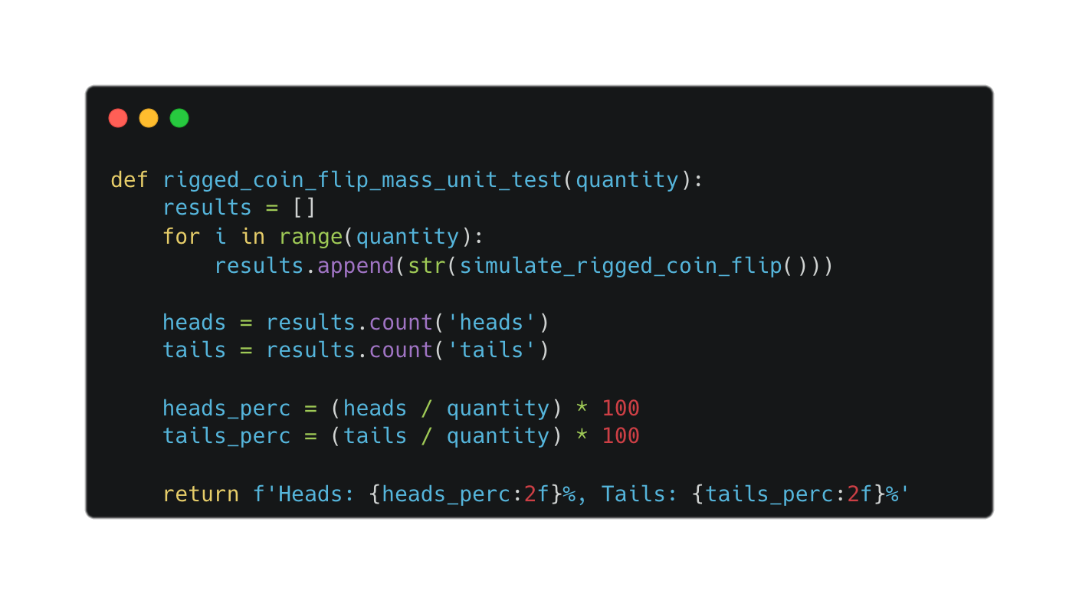
2.1.2 The fundamentals (cont)
An issue arises that we aren’t entirely sure that our algorithm is working as expected since we are only returning one score at a time.
We can mass unit test our algorithm and calculate the average number of times each side of the coin is flipped to see if our code is working correctly. If it is, we can anticipate that the percentage of tails flipped will be ~80% and the percentage of heads flipped will be ~20%.

Slide 12
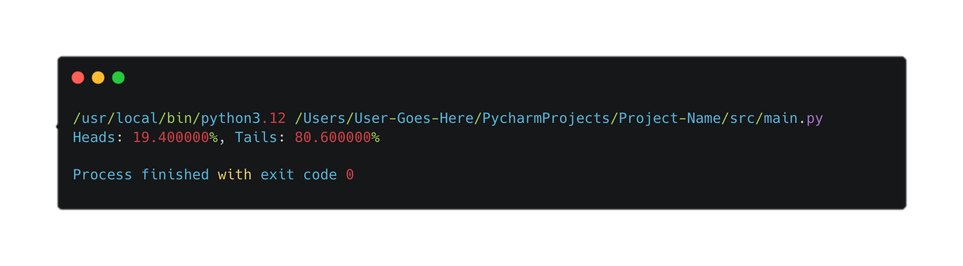
2.1.3 The fundamentals (cont)
Using the rigged_coin_flip_unit_test function to run the loaded coin flip 1000 times, we see that the percentage of heads and tails are as so:
Heads: 19.400000%, Tails: 80.600000%
Which means the test is working as expected, as the percentages are roughly 20% for heads and roughly 80% for tails.

Slide 13
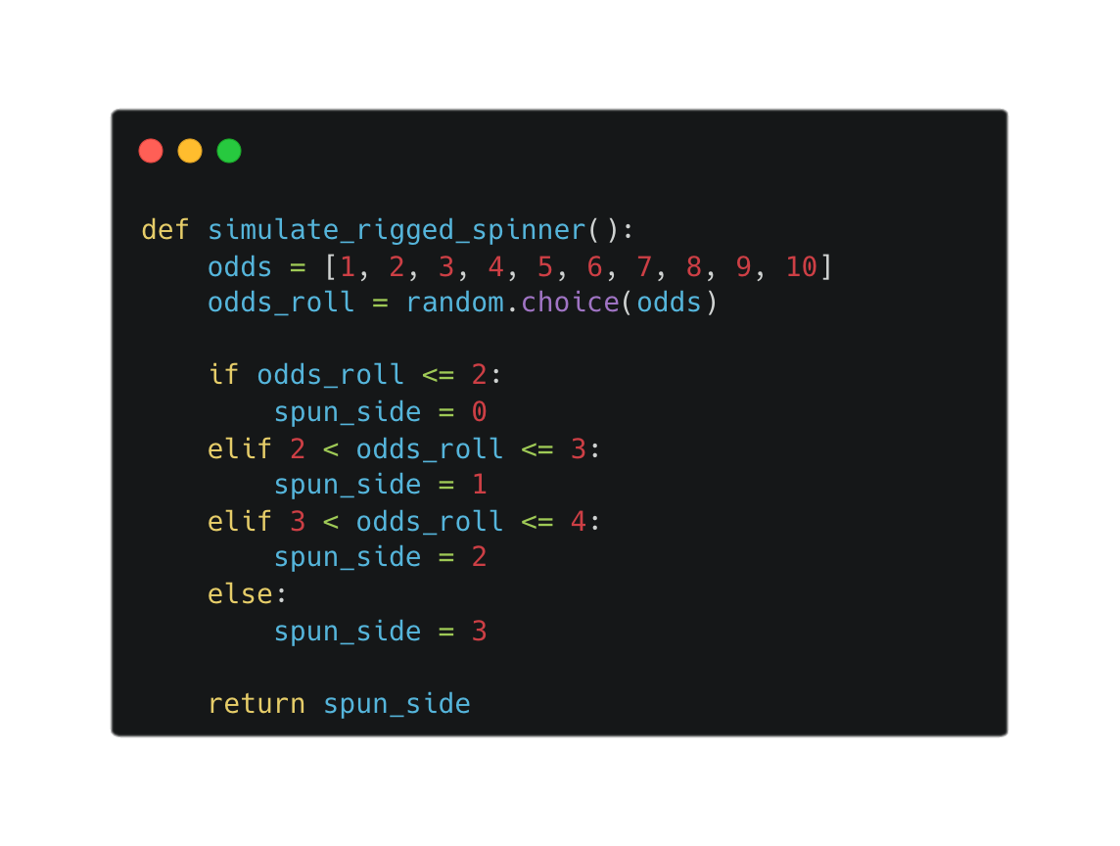
2.1.4 The fundamentals (cont)
To make a spinner with loaded odds, we can use the same concept/method we used in 2.1.1 and alter it to our new scenario. We will still use the list that contains number 1 through to 10, but we do need to change the if statement to account for our new odds
Random Number, Spinner Spun Number:
1-2, 0 (20%)
3, 1 (10%)
4, 2 (10%)
5-10, 3 (60%)

Slide 14
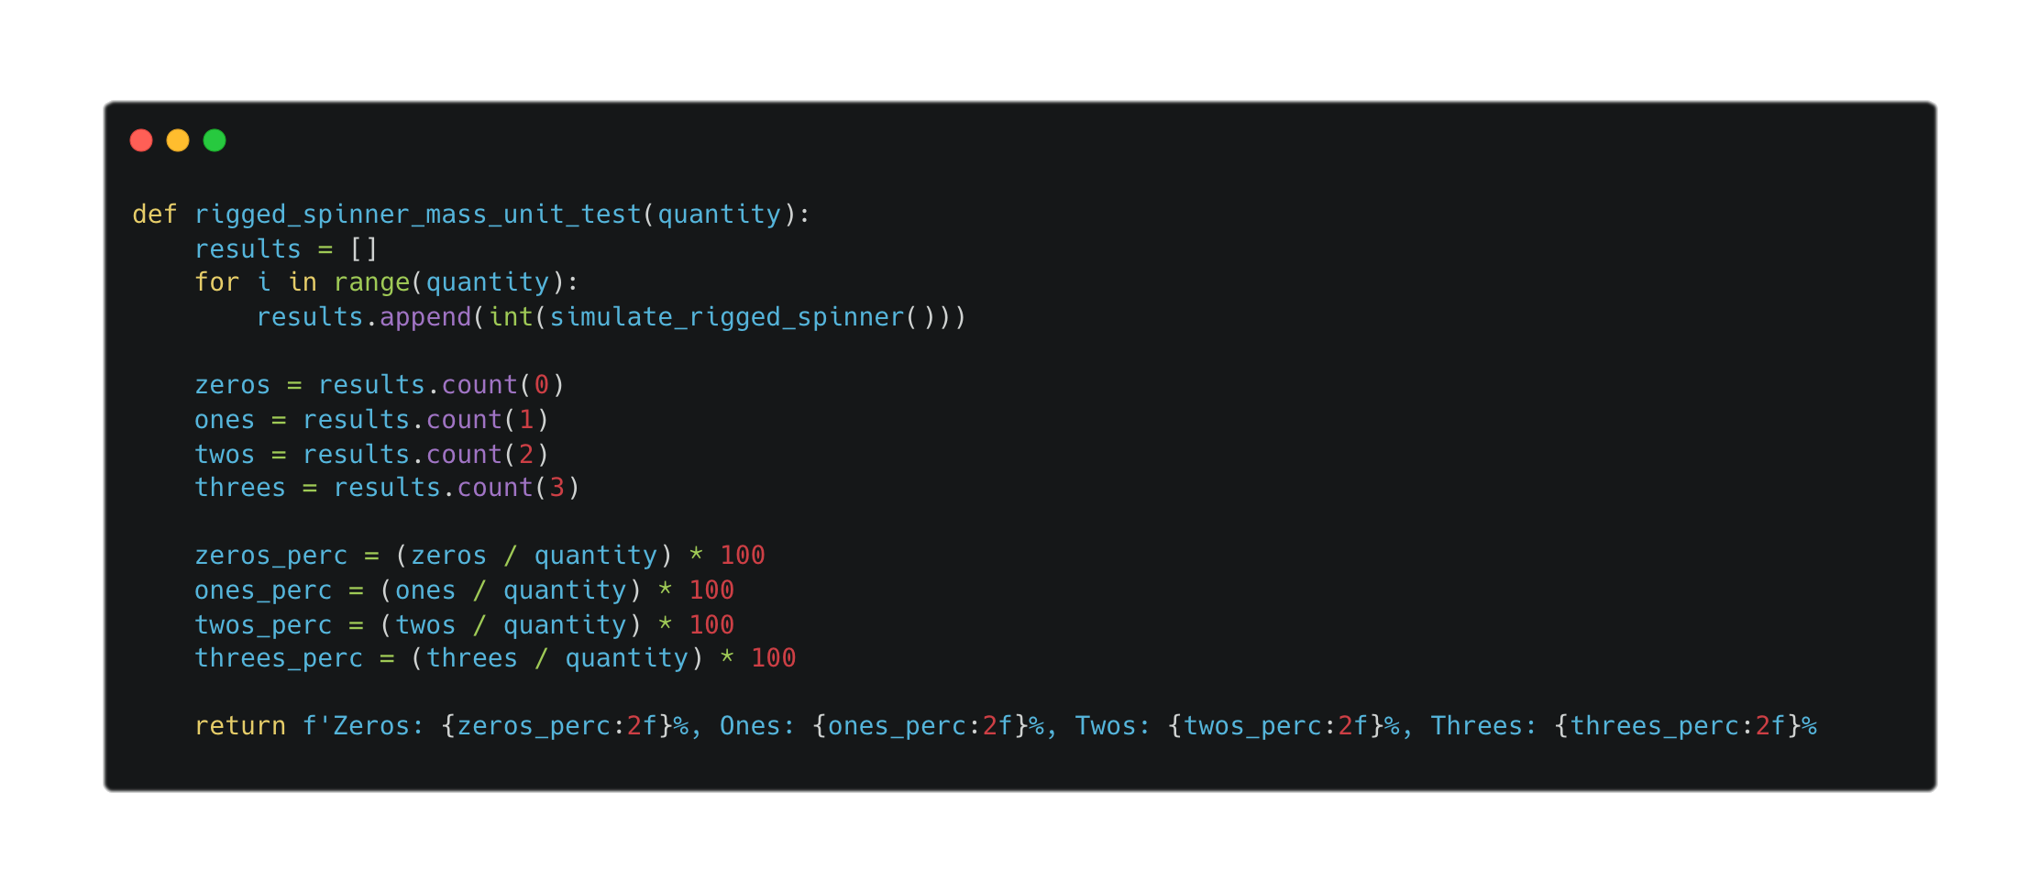
2.1.5 The fundamentals (cont)
Similar to the solution to the problem we encountered in 2.1.2 , we can use a unit test to calculate the accuracy of the function we designed in the last segment.
Random Number, Spinner Spun Number:
1-2, 0 (20%)
3, 1 (10%)
4, 2 (10%)
5-10, 3 (60%)

Slide 15
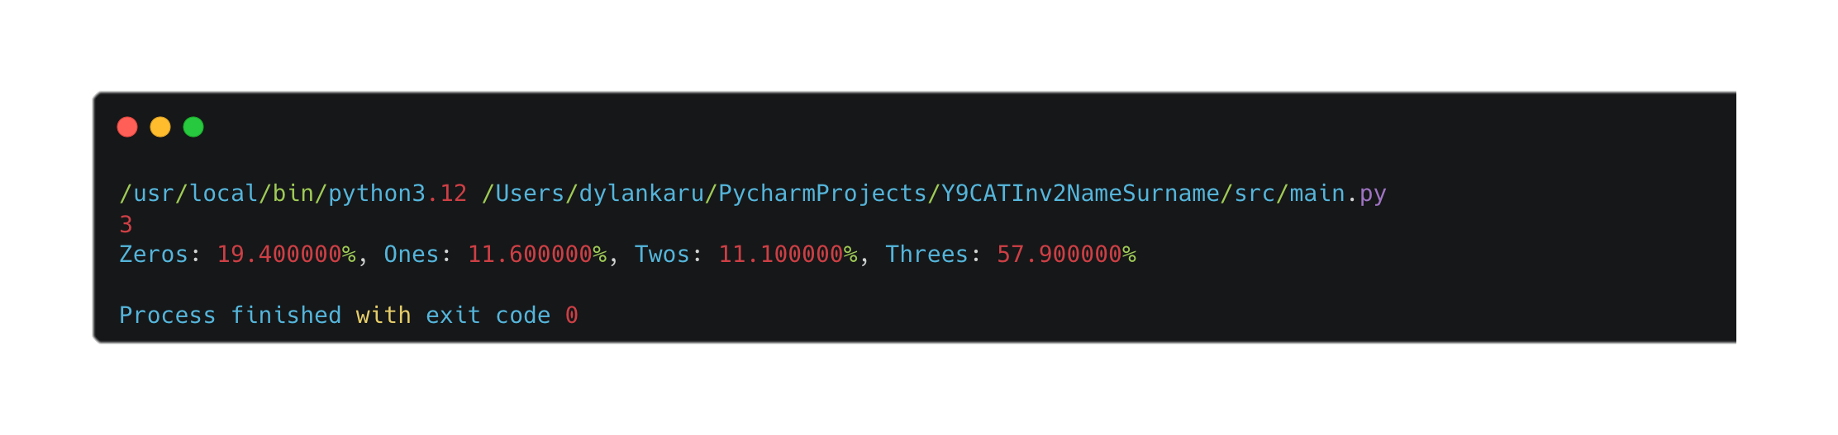
2.1.6 The fundamentals (cont)
Using the rigged_spinner_unit_test function to run the loaded spinner 1000 times, we see that the percentage of spinner options are are:
Zeros: 19.400000%, Ones: 11.600000%, Twos: 11.100000%, Threes: 57.900000%
Our results are consistent with our estimated percentages (20%, 10%, 10%, 60%)

Slide 16
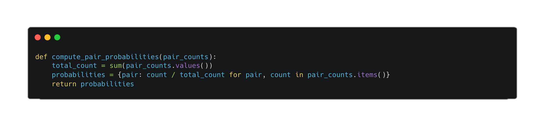
2.2.1 Sampling from the model
To calculate the probabilities of character pairs, we first determine the total frequency of all pairs by summing the values in the pair_counts dictionary. Then, we compute the probability for each pair by dividing its frequency by this total count. This results in a dictionary where each key (character pair) is associated with its probability. This approach ensures that pairs are represented proportionally to their frequency of occurrence, allowing us to understand their relative likelihood in the dataset.

Slide 17
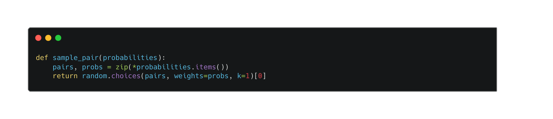
2.2.2 Sampling from the model (cont)
For sampling a character pair based on its probability, we use the random.choices function, which allows us to select an item from a list with specified weights. Here, we provide a list of character pairs and their corresponding probabilities as weights. The function returns a randomly chosen pair, where pairs with higher probabilities are more likely to be selected. This method ensures that the sampling reflects the actual distribution of the pairs in the data.

Slide 18
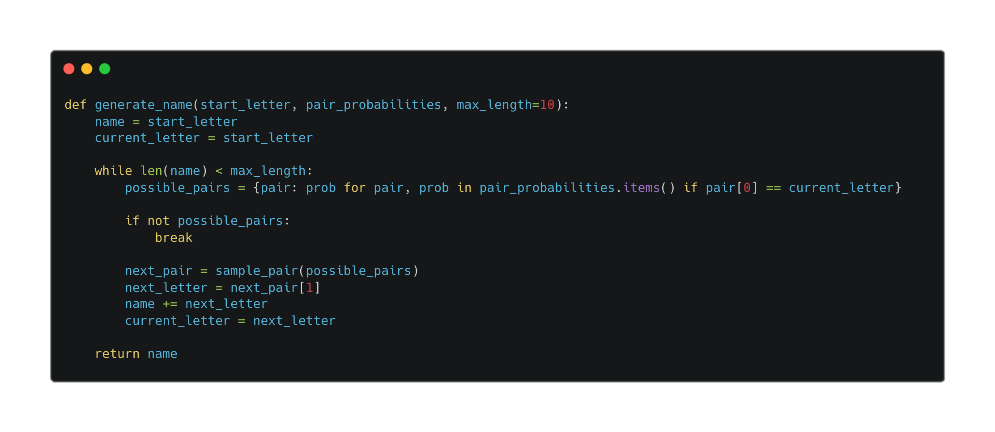
2.2.3 Sampling from the model (cont)
To generate a name-like string starting from a given letter, we sequentially build the name by appending letters based on the probabilities of character pairs. We start with the start_letter and use the pair_probabilities to find and sample the next character pair that begins with the current letter. This process continues until the name reaches the specified maximum length or no more valid pairs are available. This technique ensures that the generated string follows the probabilistic patterns observed in the input data.

Slide 19
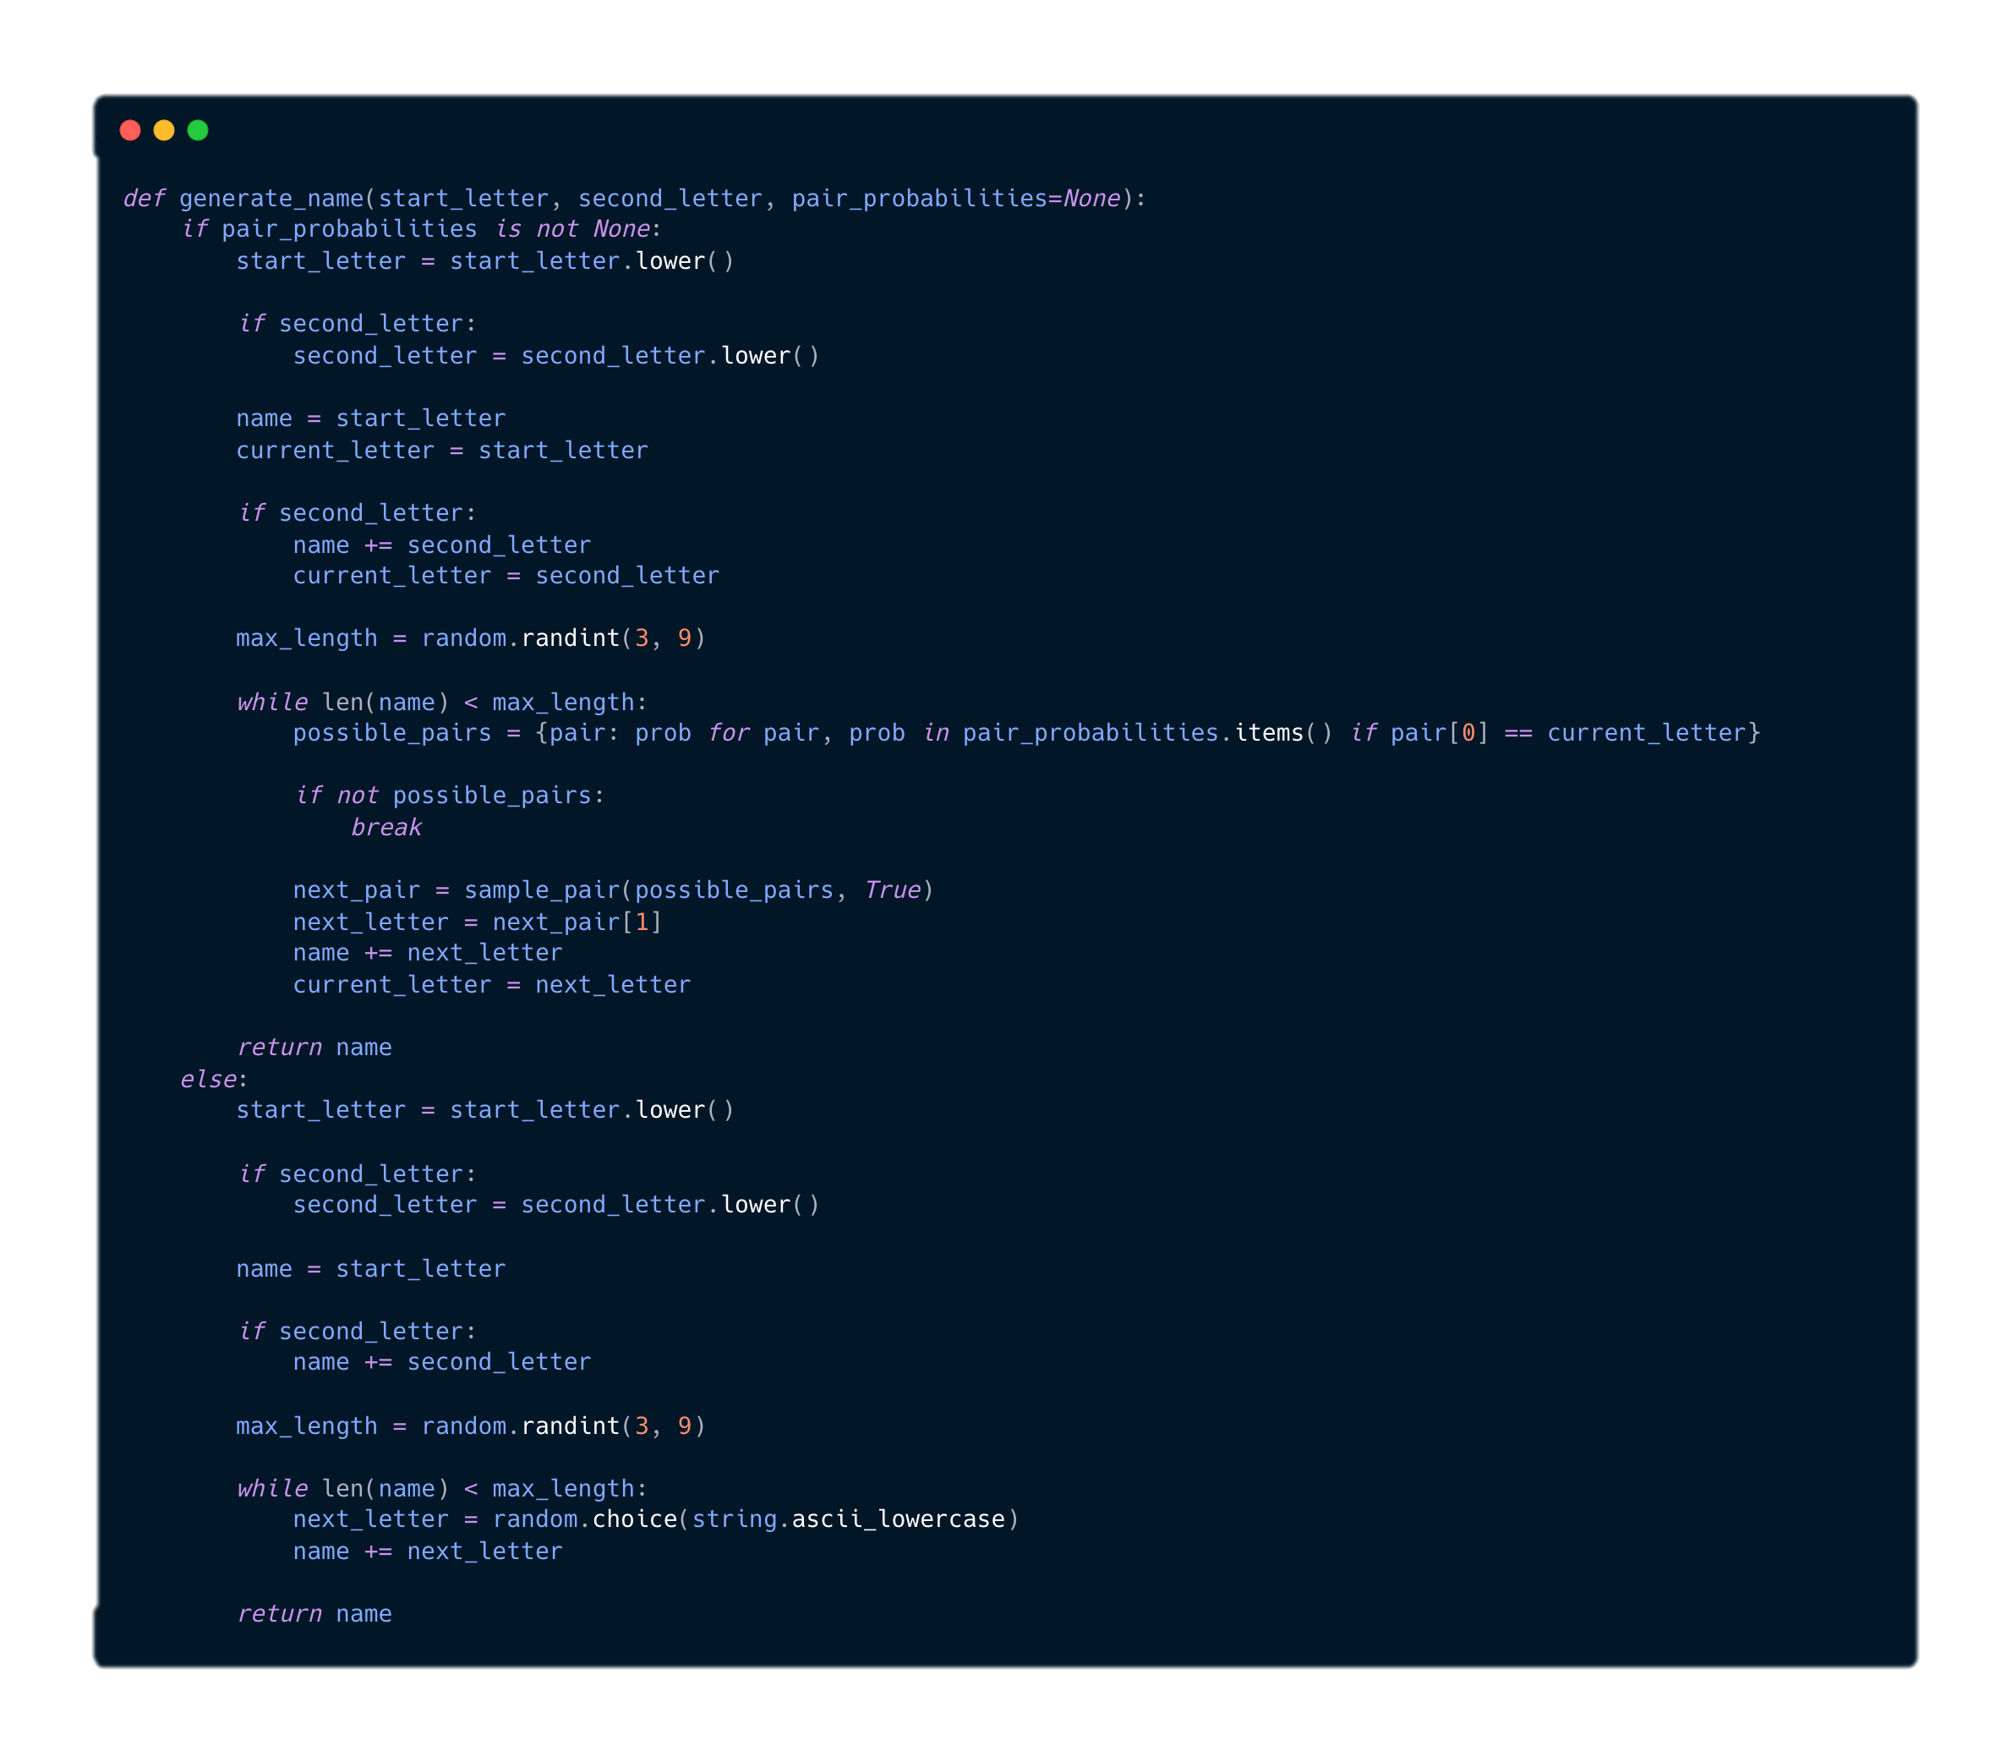
2.3.1 Evaluation
Generating names with untrained pair probabilities isn’t that hard. We can alter the sample_pair and generate_name functions to make pairs have an evenly weighted chance to be picked. Though my code doesn’t assign pairs unbiased and randomly, picking a random letter in essence achieves the same goal.

Slide 20
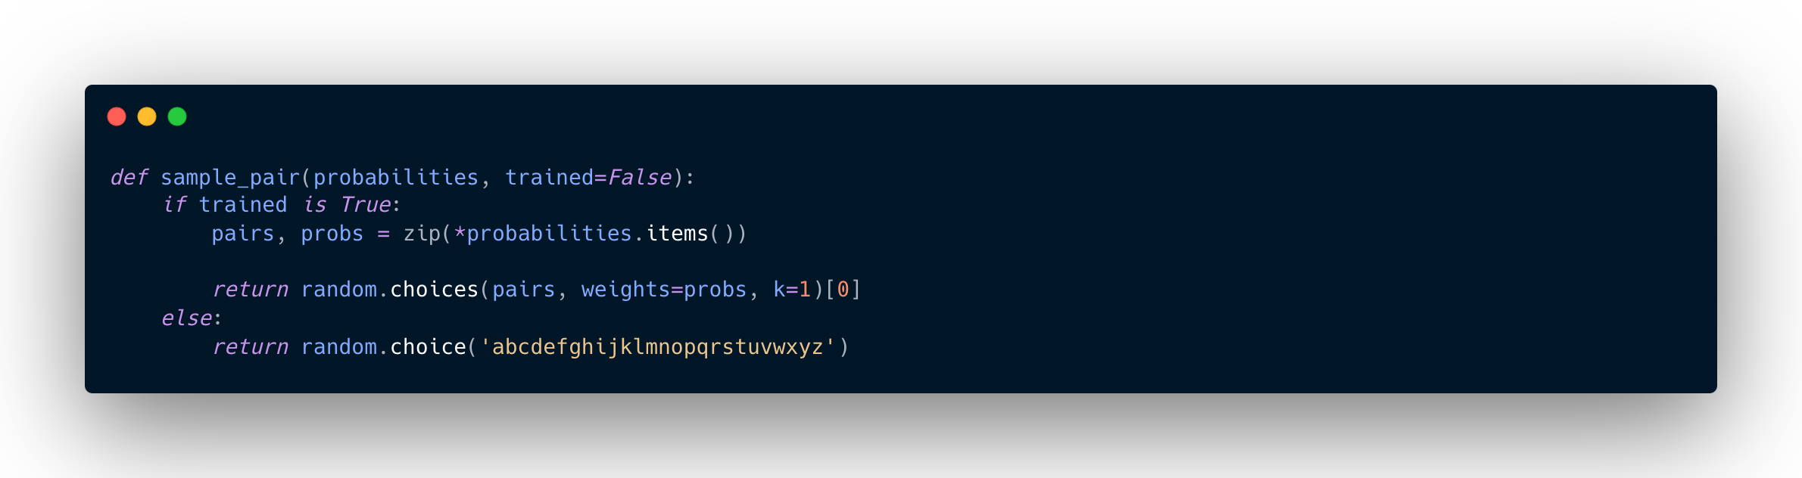
2.3.2 Evaluation

Slide 21
2.3.3 Evaluation
To evaluate the results, the names generated by the trained model are significantly more name-like than the untrained model’s generated names. The following are 10 names generated by each model:
Trained Names
Gonazorid, Phally, Wrid, Opadhlwe, Leneem, Nynaur, Ehangl, Haronnafr, Aaunnadan, Phanaiyal
Untrained Names
Wumbet, Ldfpki, Kaupygq, Bhjyuheap, Ygbqnhnut, Plpjz, Kfifxkhp, Obxquqxv, Yswtvhwge, Qjxuqtl
While none of the names seem to be genuine names, the trained model’s names seem to follow a more structure, or more believable format, for a name.

Slide 22
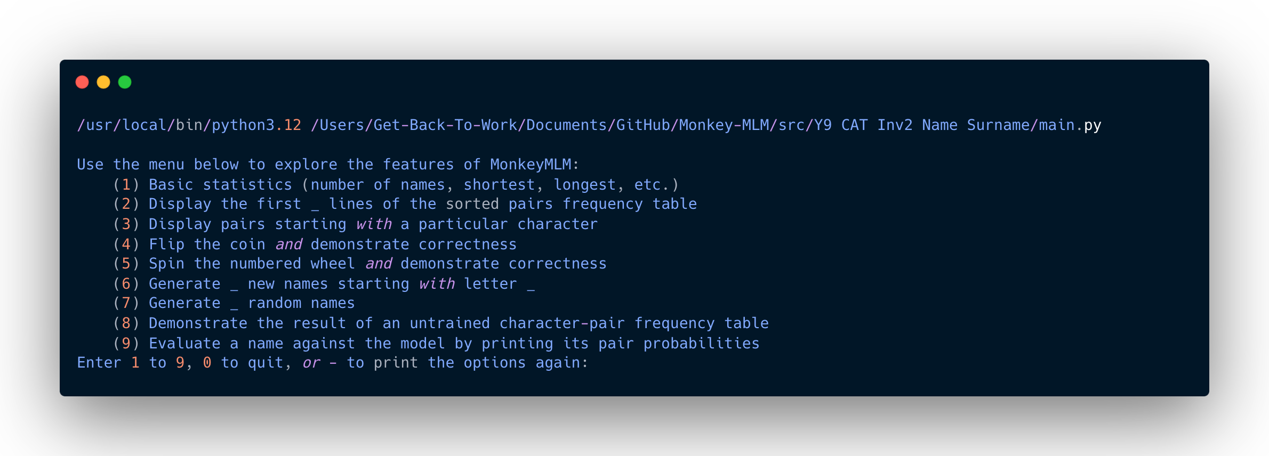
4.1 Menu
As per the requirements, I created a menu in the console that allows users navigate through the different modules and functions I created for this investigation.

Slide 23

5.1 Commits
Remote Github Repo: https://github.com/magnemint/Monkey-MLM/commits/main/

